Slide 1


Slide 2


The Pope Firm November 2015

Slide 3
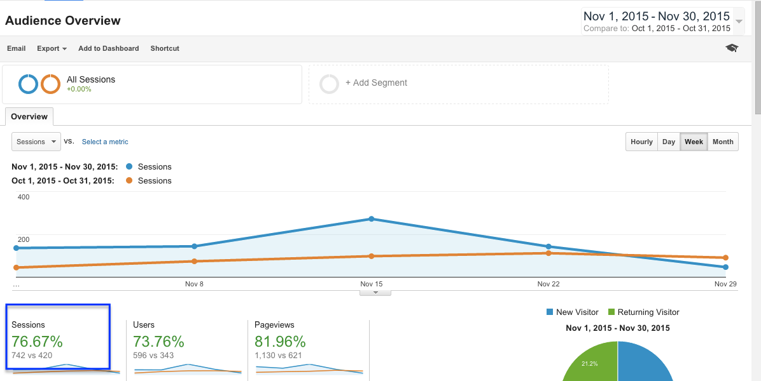
The pope firm traffic
Nov. 2015 vs oct. 2015
76% Traffic increase

Slide 4
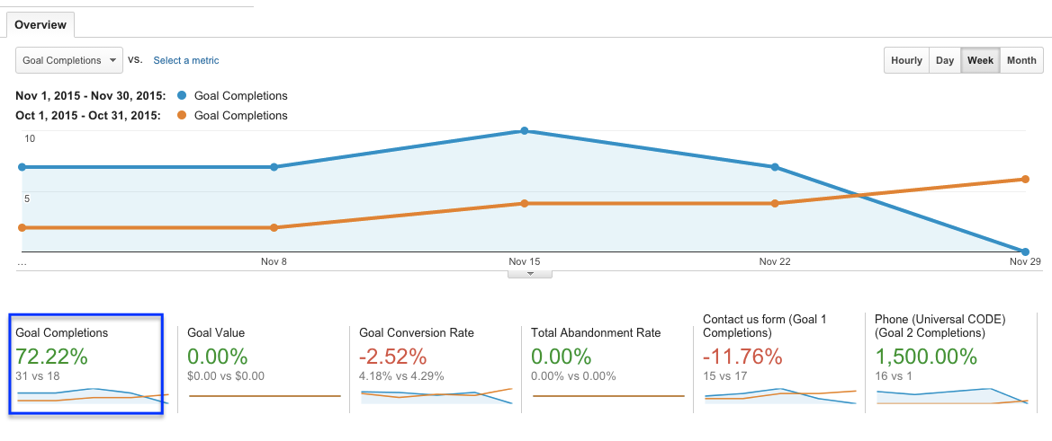
The pope firm conversions
Nov. 2015 vs oct. 2015
72% conversion increase

Slide 5
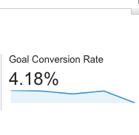
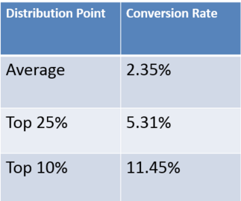
Your Conversions vs. National average
The Pope Firm: 77% above average
2014 National average over $3b in spend
Source:
http://www.wordstream.com/blog/ws/2014/03/17/what-is-a-good-conversion-rate

Slide 6
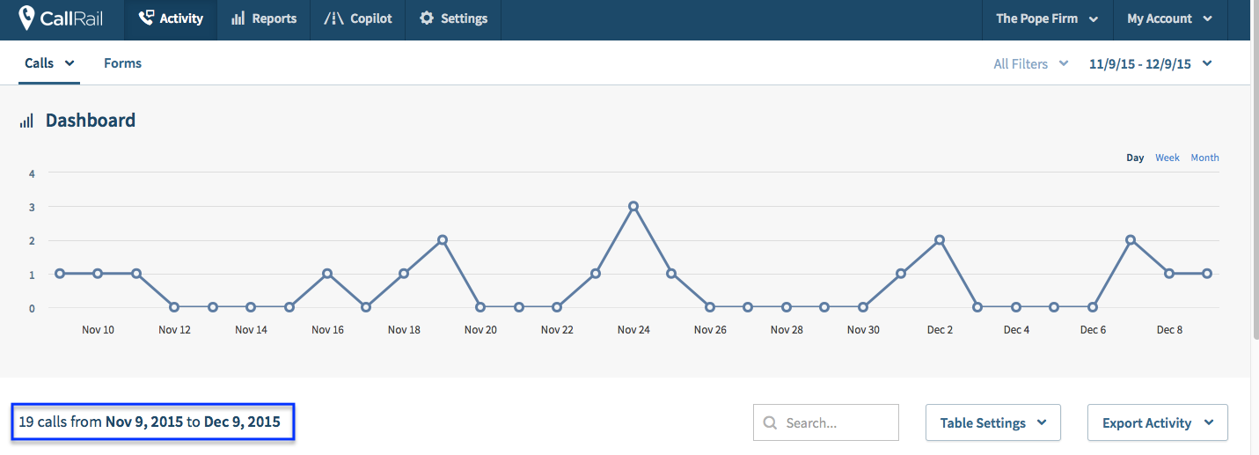
The pope firm phone calls

Slide 7
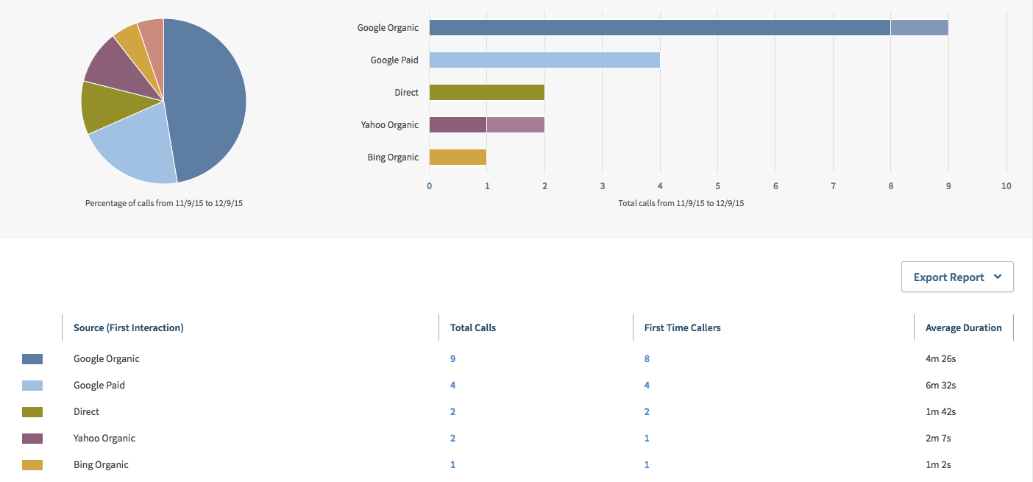
The pope firm phone calls by source

Slide 8
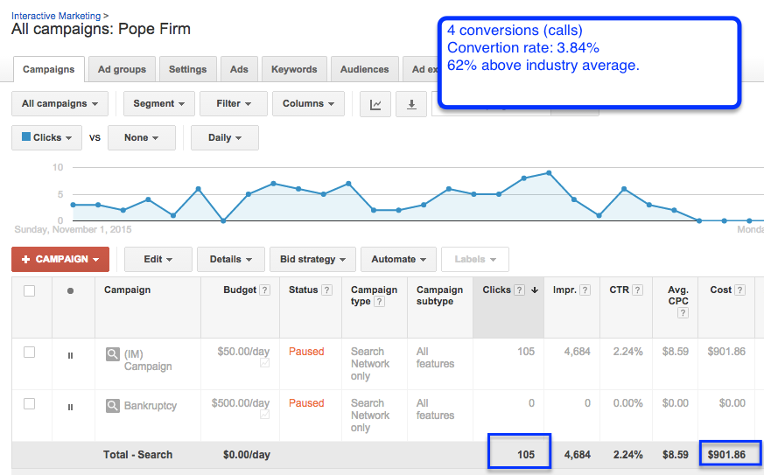
The pope firm Google Adwords

Slide 9
The pope firm Google Adwords

Slide 10
Business Directories
Built for Johnsons City (60 listings)
Optimized & Managed
1. 2findLocal
2. Addresses
3. AmericanTowns
4. Angie’s List
5. Best of the Web
6. Bing
7. BizJournals.com
8. Biznik
9. Brownbook
10. ChoiceVendor.com
11. Citysearch
12. CitySlick
13. Citysquares
14. Cylex-Usa
15. Dex
16. Dexknows
17. Discoverourtown
18. Ezlocal
19. Facebook
20. Finditnow
21. Genieknows
22. Getfave
23. Google
24. Hotfrog
25. Infignos
26. InfoUSA
27. Judysbook
28. Justclicklocal
29. Kudzu
30. Linkedin
31. Listedlocal
32. Local Site submit
33. Local.com
34. Localdatabase
35. Magic Yellow
36. Manta
37. Mapquest
38. MatchPoint
39. Merchant Circle
40. Metrobot
41. MojoPages
42. MyCity
43. Myhuckleberry
44. Navteq GPS
45. Oneclicklocal
46. Showmelocal
47. Supermedia
48. Superpages
49. TeleAtlas
50. ThinkLocal
51. Topix
52. Usdirectory
53. USYellowPages
54. Whitepages
55. Yahoo!
56. Yellowbook
57. Yellowbot
58. Yellowee
59. Yelp
60. Zipweb

Slide 11
Business Directories
Built for Kingsport (60 listings)
Optimized & Managed
1. 2findLocal
2. Addresses
3. AmericanTowns
4. Angie’s List
5. Best of the Web
6. Bing
7. BizJournals.com
8. Biznik
9. Brownbook
10. ChoiceVendor.com
11. Citysearch
12. CitySlick
13. Citysquares
14. Cylex-Usa
15. Dex
16. Dexknows
17. Discoverourtown
18. Ezlocal
19. Facebook
20. Finditnow
21. Genieknows
22. Getfave
23. Google
24. Hotfrog
25. Infignos
26. InfoUSA
27. Judysbook
28. Justclicklocal
29. Kudzu
30. Linkedin
31. Listedlocal
32. Local Site submit
33. Local.com
34. Localdatabase
35. Magic Yellow
36. Manta
37. Mapquest
38. MatchPoint
39. Merchant Circle
40. Metrobot
41. MojoPages
42. MyCity
43. Myhuckleberry
44. Navteq GPS
45. Oneclicklocal
46. Showmelocal
47. Supermedia
48. Superpages
49. TeleAtlas
50. ThinkLocal
51. Topix
52. Usdirectory
53. USYellowPages
54. Whitepages
55. Yahoo!
56. Yellowbook
57. Yellowbot
58. Yellowee
59. Yelp
60. Zipweb

Slide 12



New Ad Strategy for Google Adwords Display

Slide 13

Next Steps
Expand SEO to on the page.
Expand Google Adwords strategy to ads.
Add phone numbers to ads.

