Slide 1
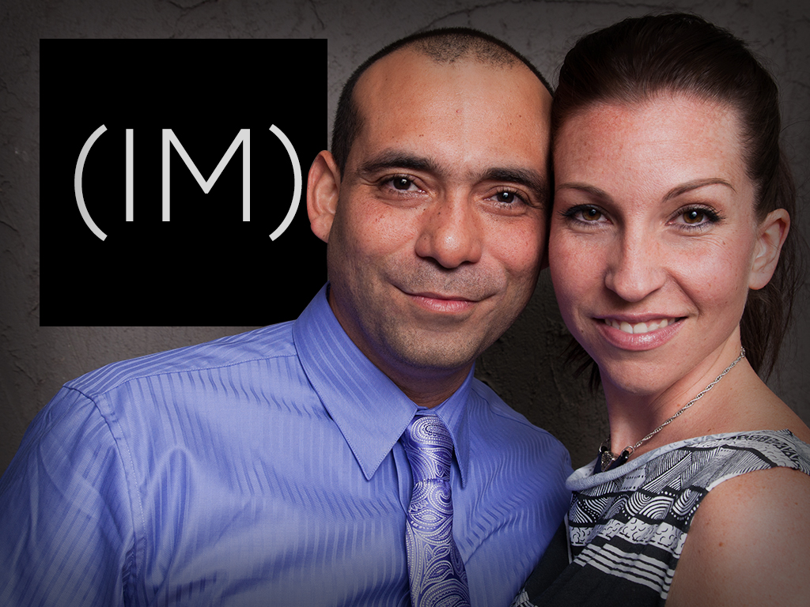
Thank you for the opportunity to share with you our work and results. We are here to be of service, and available to discuss with you how we can best help you meet your goals.
To schedule a call with us please click here: schedule a call
Rafa & Chelsea

Slide 2
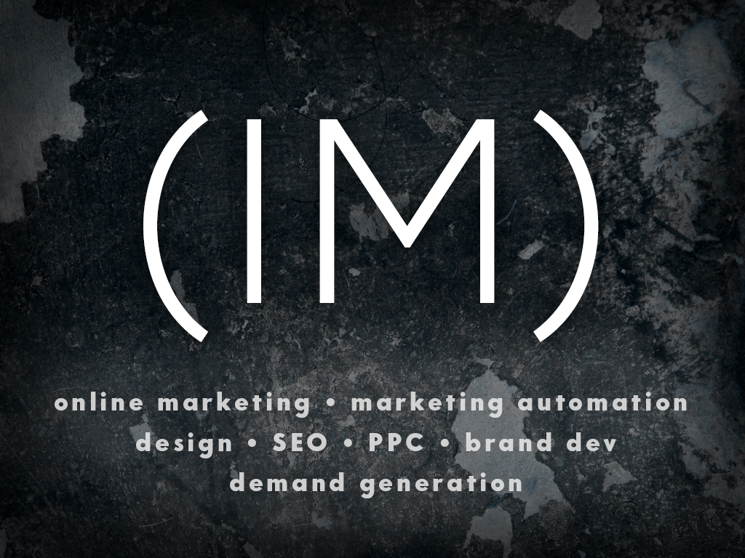

Slide 3


Mr. Roofer of Atlanta
Full Service Client Case Study
(Local SEO, SEO, PPC, Web Design, Analytics, Strategy)

Slide 4
Results Highlights:
140% increase in total traffic year over year.
  Decreased PPC spend by 100%
202% increase in visitor to lead conversion rate.
Current rate is 1,254% greater then national averages (33% conversion rate)
515 phone calls generated in the month of Nov.
91 #1 page rankings in Google.

Slide 5
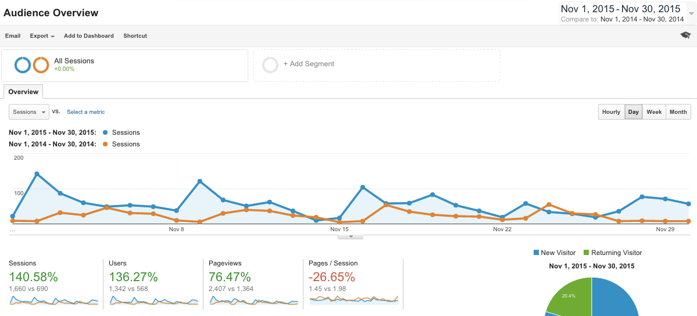
Mr. Roofer Traffic
Nov. 2015 vs Nov. 2014
140% Traffic increase

Slide 6
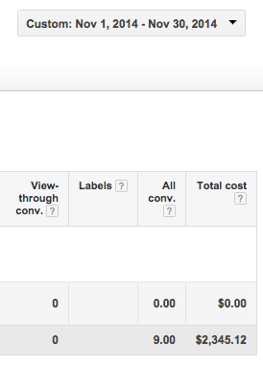
Traffic increased even with out PPC
In November 2014 we spent $2,345 with Google Adwords.
In November 2015 we spent $0.
We have increased organic traffic to beat PPC traffic, and in results decreased PPC spend by 100%

Slide 7
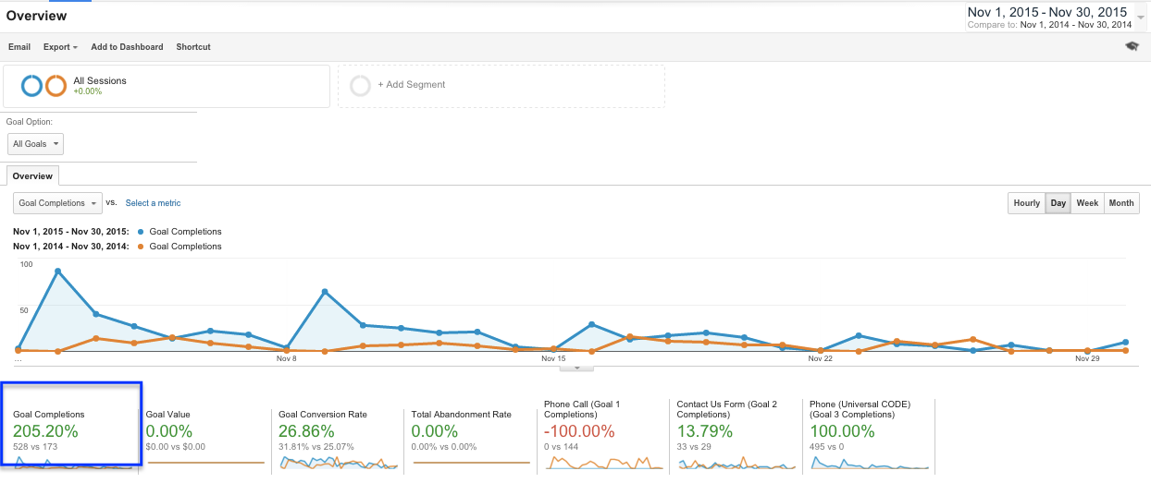
Mr. Roofer conversions
Nov. 2015 vs Nov. 2014
206% increase

Slide 8

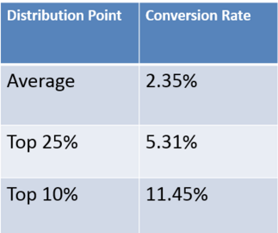
Your Conversions vs. National average
Mr. Roofer:
1,254% above average
2014 National average over $3b in spend
Source:
http://www.wordstream.com/blog/ws/2014/03/17/what-is-a-good-conversion-rate

Slide 9
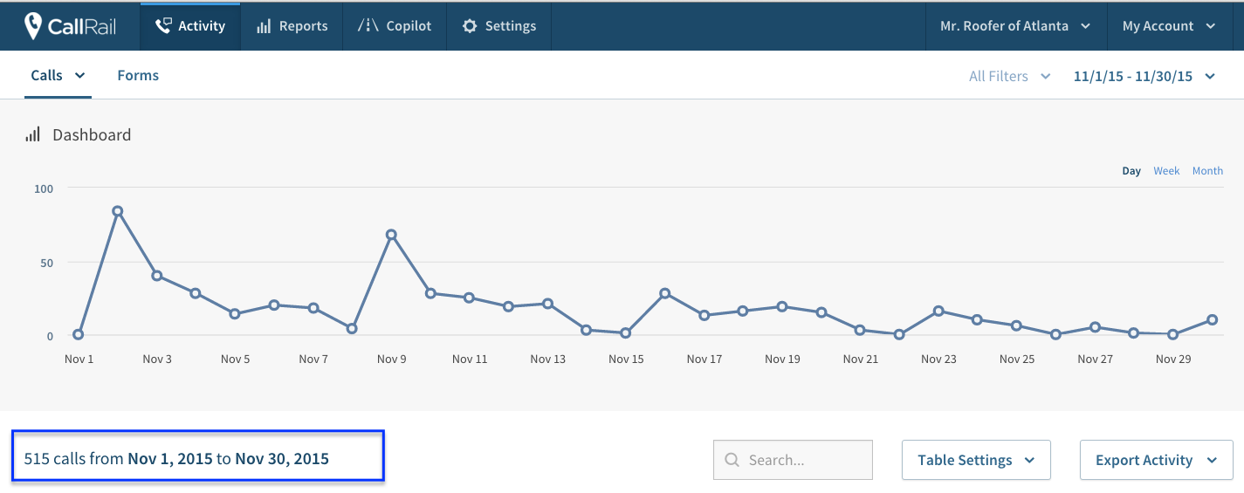
Mr. Roofer phone calls

Slide 10
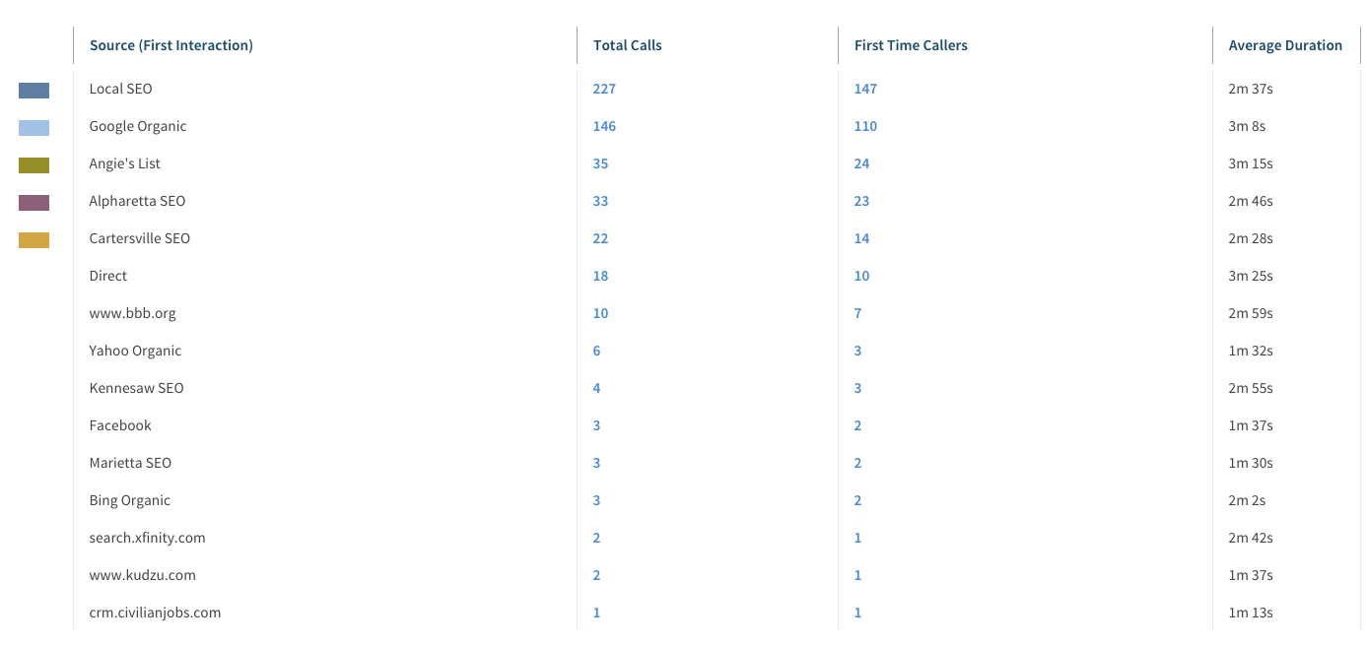
Mr. Roofer phone calls by source

Slide 11
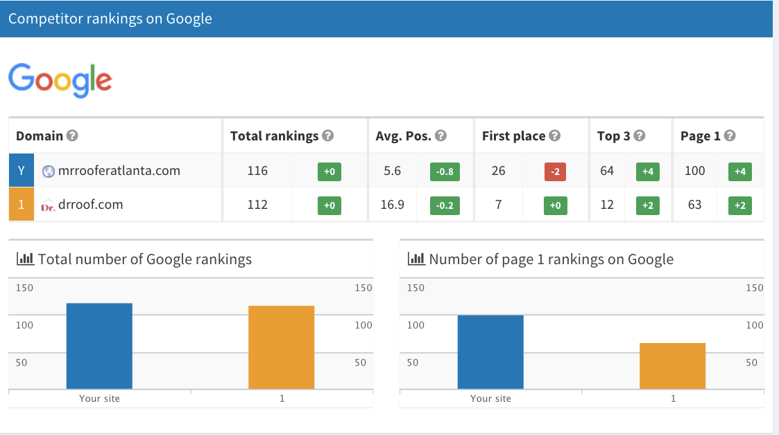
Mr. Roofer vs dr. roof
(top competitor)

Slide 12
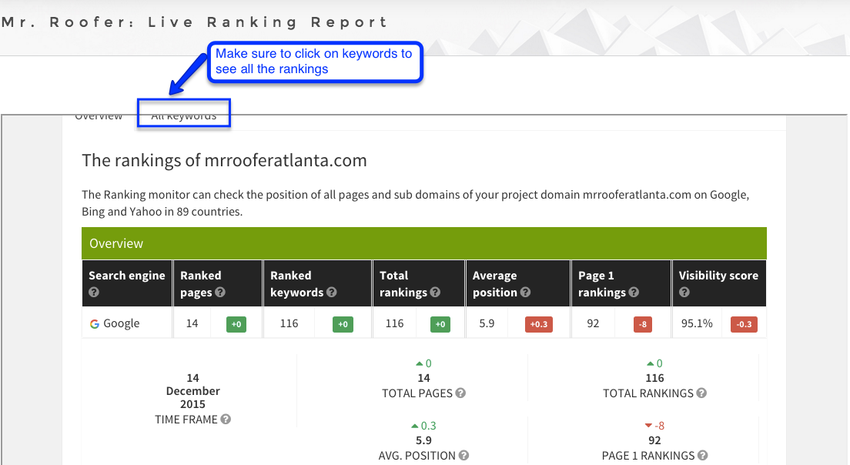
Click here to see live report OF all rankings: http://www.interactivemarketing.net/im-mrroofer-monthly-reporting/
(it is must see, mr. roofer dominates)

Slide 13
Thank you for the opportunity to share with you our work and results. We are here to be of service, and available to discuss with you how we can best help you meet your goals.
To schedule a call with us please click here: schedule a call
Rafa & Chelsea

